Slide 1



Sharing of IPS (sIPS) https://profiles.ihe.net/ITI/sIPS
John Moehrke
<JohnMoehrke@gmail.com>
Co-Chair: IHE ITI Technical Committee
Notes:
The “Sharing of IPS” profile is part of IHE contribution to the IPS cross-SDO collaborative.
I will cover a short introduction to the IPS, Document Sharing, and the variations supported.
I am John Moehrke, Co-Chair of IHE IT-Infrastructure Committee, and employee of ByLight Consulting.

Slide 2

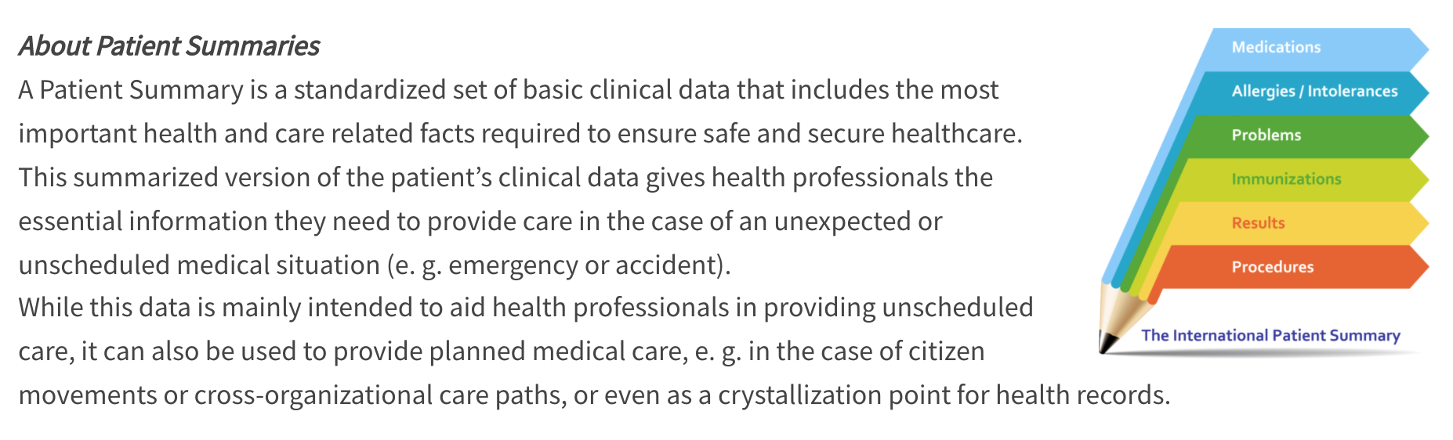


What is the IPS?
https://international-patient-summary.net/
Cross-SDO collaborative
A standardized set of basic clinical data
Includes most important health and care related facts
A summarized version of a patient’s clinical data provides health professionals the essential information needed for care
The International Patient Summary is a minimal and non-exhaustive set of basic clinical data of a patient, specialty-agnostic, condition-independent, but readily usable by all clinicians for the unscheduled (cross-border) patient care.
Notes:
Cross-SDO collaboration, each SDO providing standards artefacts designed to be complementary, and highlighting the strengths of each SDO. CEN and ISO provide specifications that define the data model and IPS content; HL7 contributed 2 implementation guides designed to assist implementers with both FHIR and CDA implementations. SNOMED International supplied a free IPS terminology set with accompanying hierarchical ontology. And IHE, with the sIPS, showing how easily IPS fits within existing Document Sharing infrastructure with conformance testing at IHE-Connectathon, and with upcoming use-case specific clarifications on the use of IPS content.
IPS is a standardized set of basic clinical data
It Includes most important health and care related facts, such as Medications, Allergies, Problems, Immunizations, Results and Procedures
A summarized version of a patient’s clinical data provides health professionals the essential information needed for care. It is not an exhaustive extract of the patient record.
Although originally designed for cross-border unscheduled care, the IPS has also been implemented to support both scheduled and unscheduled care within a particular country, crossing other boundaries such as provinces, states, cities, and even organizations. Although designed to ensure global adoption across national borders, the IPS has been recognized as a useful tool to support care across any geographic or organizational boundary.

Slide 3
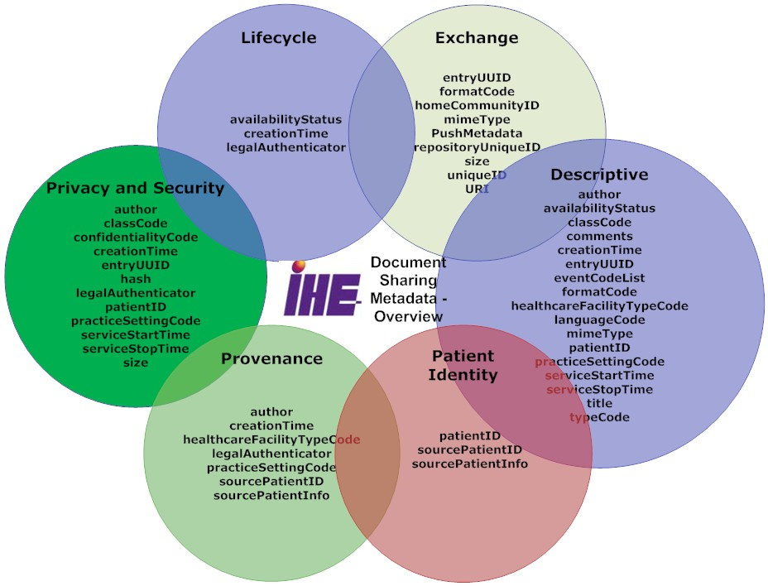
IHE Document Sharing
Metadata enable discovery, privacy, identity, lifecycle, exchange, and provenance
Content agnostic
CDA, C-CDA, C32, etc
FHIR Documents
DICOM Documents
PDF/Text
Graphics (JPEG, MPEG, TIFF…)
Document Relationships
Transforms
Signs
Replaces
Special
On-Demand Document
Delayed Document Assembly
EMR
FHIR IPS
C-CDA
CDA-IPS
C32
PDF
https://profiles.ihe.net/ITI/HIE-Whitepaper/index.html
Notes:
Document Sharing is a family of topology solutions. Starting 20 years ago with Cross-Enterprise Document Sharing (XDS), and most recently the Mobile Health Document Sharing (MHDS) that is based completely on FHIR infrastructure.
Key to Document Sharing is a defined Metadata model that enables discovery, privacy, identity, document lifecycle, exchange methods, and provenance.
Document Sharing is specifically content agnostic, so any kind of document can be shared.
Formal healthcare documents like CDA have been the implementation focus, but the solution is not limited to CDA.
Supporting FHIR-Documents with no need to change Document Sharing at all
Other document types include DICOM, PDF, Text, and images.
Specifically Document, in Document Sharing, is a very unconstrained concept, not limited to formal “documents”, including any kind of file.
Within Document Sharing there are relationships between document entries. Transforms, Signs, and Replaces can be used to show lifecycle management of documents. Shown in blue is an example where an EMR publishes an IPS, and then publishes a set of transforms in other syntactic formats. All are the same semantic content, so they all clearly show their parentage to the IPS content.
There are also special kinds of document entries such as On-Demand, and Delayed Document Assembly. More on On-Demand later.

Slide 4


Source
Systems
IHE
Document Sharing
Recipient
Systems
IPS Document
Clinician
1
PUSH IPS to recipient system:
MHD (RESTful push)
XDR (document reliable messaging)
XDM (reliable media, including email)
Clinician
Source
System
IPS
Document
(MHD)
Document
Source
(MHD)
Document
Recipient
Recipient
System
Content
Creator
2
Recipient system PULLs IPS from HIE:
XDS (Query/Retrieve)
MHD (Query/Retrieve)
XCA (Federated Query/Retrieve)
Content
Consumer
HIE as Source
System
PHR
System
Document
Repository
HIE(s)
Document
Repository
(MHD)
Document
Consumer
(MHD)
Document
Recipient
(MHD)
Document
Responder
Patient
Responding
Gateway
Initiating
Gateway
On-demand IPS
Document
On-demand Document
Source
3
Recipient system PULLs On-Demand IPS from HIE (as Source System)
which plays the role of a Content Creator.

Slide 5
Detailed Requirements in sIPS
Content Creators must make IPS document conformant to HL7 FHIR IPS Implementation Guide
Defined FormatCode that identifies that the document is conformant to HL7 IPS encoding specification.
Content Creators and Content Consumers must be grouped with one of the IHE Document Sharing Transports (XDS, XCA, XDR, XDM, MHD, MHDS, etc)
IHE Integration Statement must be published
Content Consumers must have some use of the content (view, import, etc)

Slide 6
IHE Connectathon
1. Testing to the IPS data model specification by ISO, and to the FHIR Implementation Guide supplied by HL7, using the HL7/Mitre validation tooling
2. Testing Document Sharing, using IHE Gazelle/NIST testing tools
3. Testing that the IPS can be queried, retrieved, published, and/or pushed
4. Higher Level Use-cases: Transfer of Care, EMS support and transport, Maternal Health, Care Plans
5. Regional Specializations – Canada, USA, Netherlands, Switzerland, Italy, etc…
Notes:
IHE Connectathon is about testing both at the Profile level, but also at the overall workflow.

Slide 7
Questions?
https://profiles.ihe.net/ITI/sIPS
https://international-patient-summary.net
https://profiles.ihe.net/ITI/HIE-Whitepaper/index.html
JohnMoehrke@gmail.com

